Slide 1
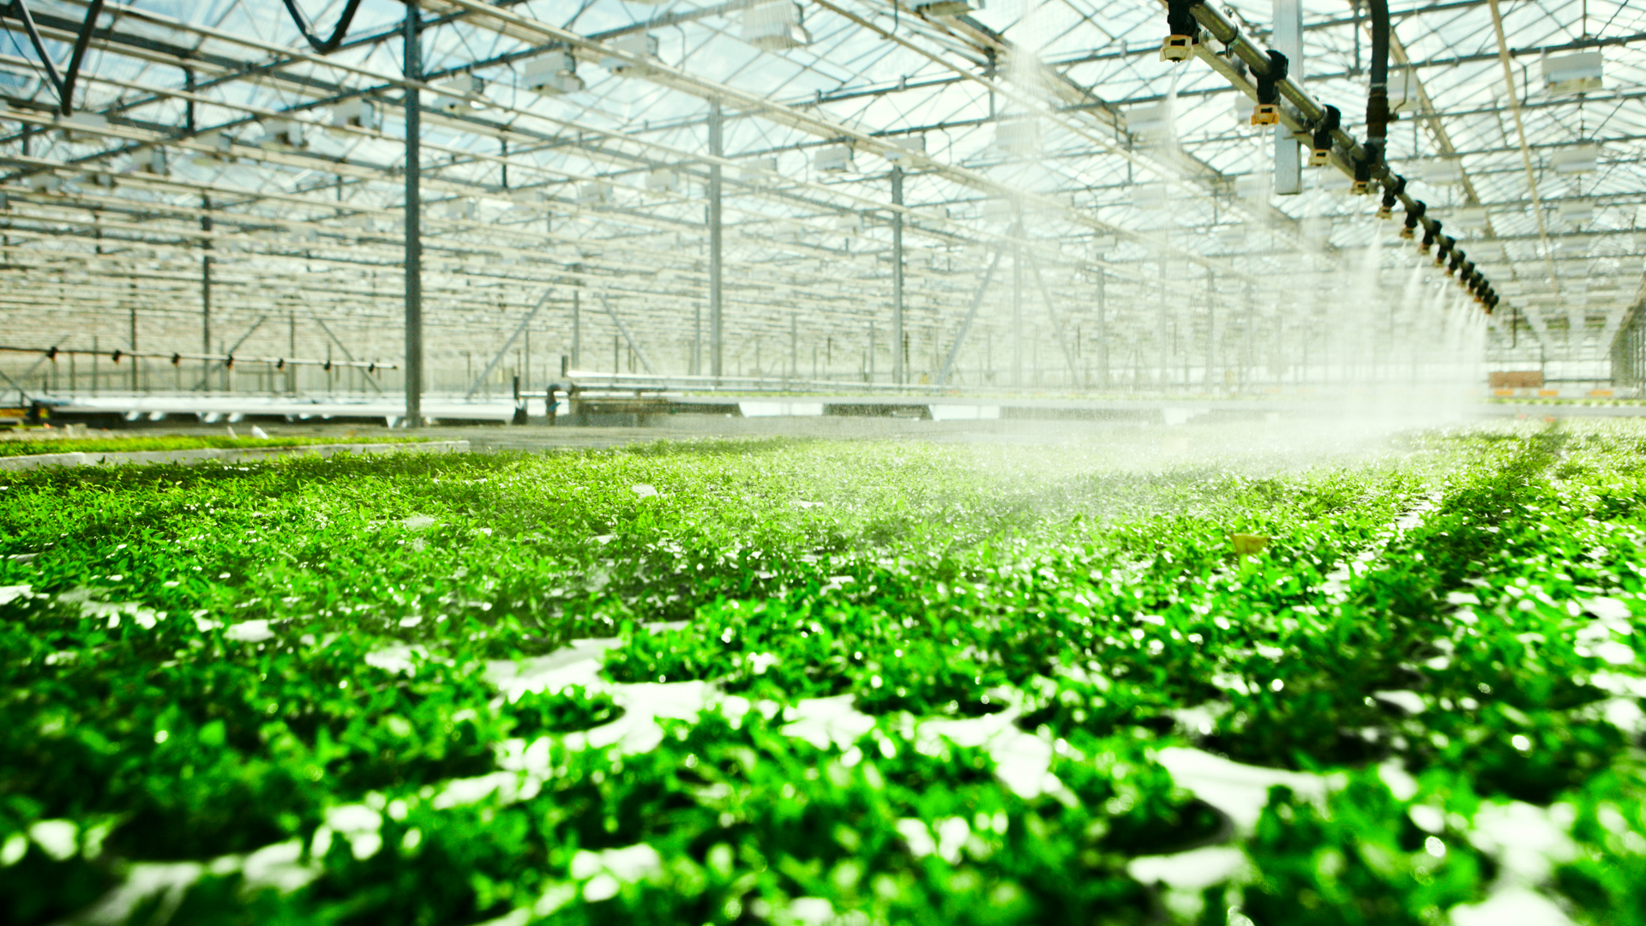
NEW AGE FARMING WITH AGRILSYT
A study on how data can bring the next green revolution
Sarvari Ventrapragada
DSO 510
October 2015

Slide 2
Background & Challenges
Indoor farming uses a highly controlled environment of light, water and other factors to grow fruits and vegetables
Uses technology to make year round farming feasible
Adaptable in cities where land, water, energy is scarce
Requires 10% less land and 20% less water
Different sensors measure temperature, lighting, PH levels, water, humidity
Data is scattered and don’t talk to each other
Farmers collect yield data manually
Spend a lot of time aggregating and analyzing the data

Slide 3
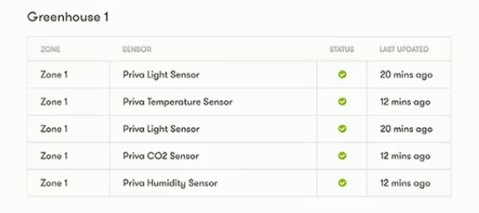
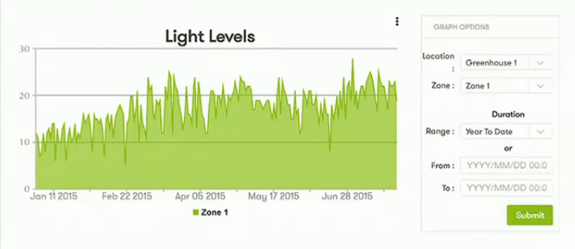
What does Agrilyst do?
Agrilyst is an analytics platform that syncs automatically with all the sensors in the greenhouse and provides an interactive dashboard
Farmers can also enter their own data and can now dig deeper into the integrated data
Provides graphs and real time task management capabilities
Analyzes data and provides recommendations
Less yield expected - Notify distributors
More water required - Take action now

Slide 4
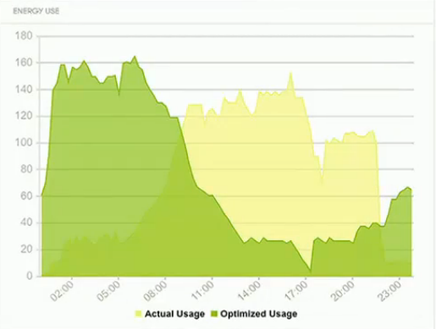
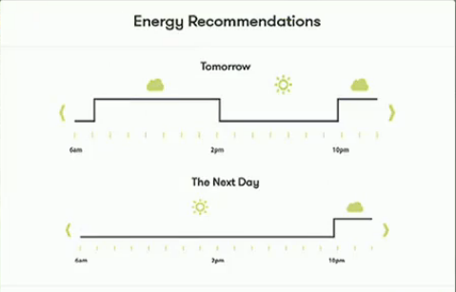
Energy Savings
Recommends energy usage pattern by considering time varying electricity rates in your region
By turning lights on an off as suggested, Farmers can save up to $150 per day and nearly $50,000 per year in electricity bills

Slide 5

The Value Created?
Food production needs to be doubled by 2050 in order to tackle rising global food shortage
Indoor farming bridges the gap between where food is grown and consumed, cutting down supply chain costs
No dependence on environmental factors
Data can help in efficient greenhouse management thereby increasing yields and profits for farmers
Encourages more growers to adapt indoor farming

Slide 6
Business Model & Takeaways
Agrilyst charges $1000 per month per sq. acre
Tie ups with hardware installers and distributors for acquiring new customers
Market size of Indoor farming is estimated to be $9 Billion
Technology and Data can enable innovation in non traditional industries
With more industries using smart devices and increasing data collection, Analytics As A Service can be a potential delivery model in traditional and non traditional industries

